Slide 1
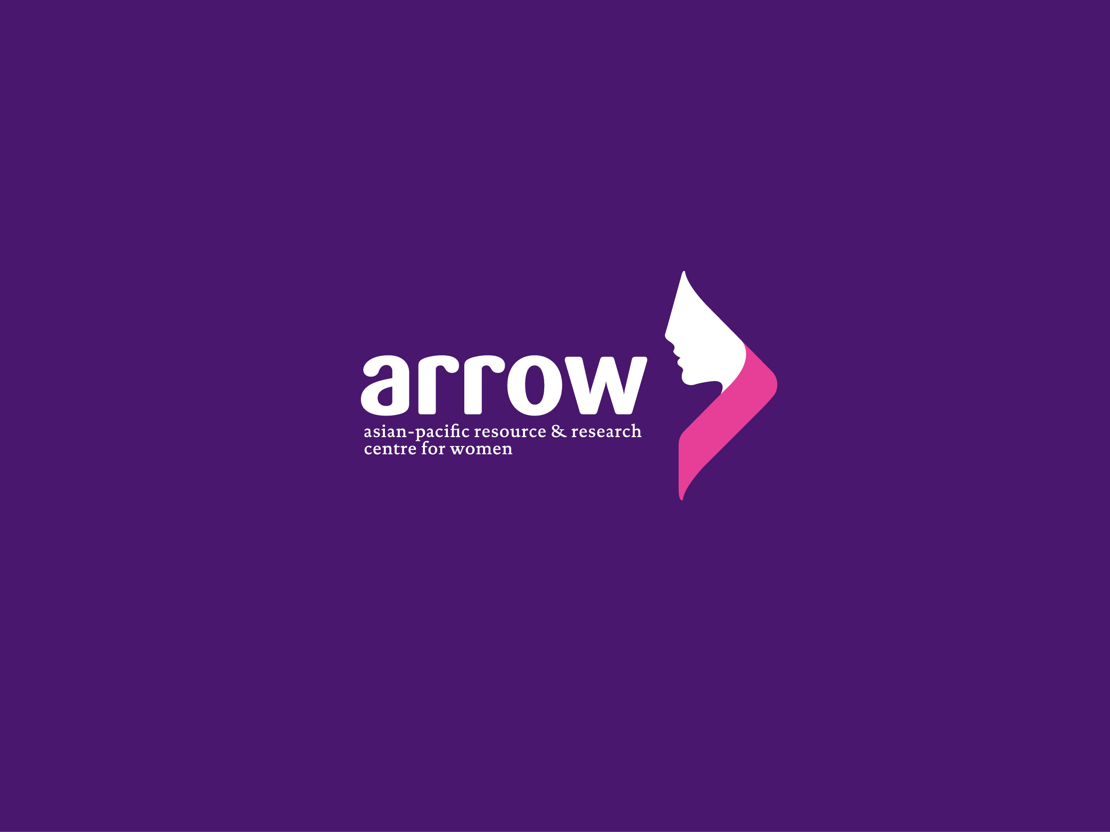

Slide 2

CAPACITY STRENGTHENING WORKSHOP
Youth Sexuality and Intersections with Education, Health, Employment, Law, and Citizenship
Notes:
Photo source: http://www.themreport.com/wp-content/uploads/2018/01/iStock-846997320-300x181.jpg

Slide 3

SESSION 4
Sexuality and Education

Slide 4
Session 4 Input
Comprehensive Sexuality Education (CSE)

Slide 5
What is CSE?
CSE is a curriculum-based process of teaching and learning about the cognitive, emotional, physical and social aspects of sexuality. It aims to equip children and young people with knowledge, skills, attitudes and values that will empower them to:
realise their health, well-being and dignity;
develop respectful social and sexual relationships;
consider how their choices affect their own well-being and that of others; and
understand and ensure the protection of their rights throughout their lives.
Notes:
:Source: UNESCO, UNAIDS, UNFPA, UNICEF, UN Women and WHO. International Technical Guidance on Sexuality Education: An Evidence-informed Approach (Revised ed.). Paris, Geneva, and New York: UNESCO, 2018. http://www.unaids.org/en/resources/documents/2018/international-technical-guidance-on-sexuality-education.

Slide 6
Why CSE?
There is clear and compelling evidence for the benefits of high-quality, curriculum-based CSE.
CSE empowers children and young people to take control and make informed decisions about their sexuality and relationships freely and responsibly.
CSE enables them to develop accurate and age-appropriate knowledge, attitudes, and skills; positive values, including respect for human rights, gender equality, and diversity, and, attitudes and skills that contribute to safe, healthy, positive relationships. It can help young people reflect on social norms, cultural values, and traditional beliefs, to better understand and manage their relationships with peers, parents, teachers, other adults and their communities.
CSE plays a central role in the preparation of young people for a safe, productive, fulfilling life in a world where HIV and AIDS, sexually transmitted infections (STIs), unintended pregnancies, gender-based violence (GBV) and gender inequality still pose serious risks to their well-being.
Notes:
Source: UNESCO, UNAIDS, UNFPA, UNICEF, UN Women and WHO. International Technical Guidance on Sexuality Education: An Evidence-informed Approach (Revised ed.). Paris, Geneva, and New York: UNESCO, 2018. http://www.unaids.org/en/resources/documents/2018/international-technical-guidance-on-sexuality-education.

Slide 7
Why CSE?
UNESCO 2016 Evidence Review showed that CSE (especially as part of multi-component programmes, particularly when linked with youth friendly health services) has positive effects:
Contributes to:
  Delayed initiation of sexual intercourse
  Decreased frequency of sexual intercourse
  Decreased number of sexual partners
  Reduced risk taking
  Increased use of condoms
  Increased use of contraception
Improves knowledge about different aspects of sexuality, behaviours, and risks of pregnancy or HIV and other STIs, and improves attitudes related to SRH.
Does NOT increase sexual activity, sexual risk-taking behaviour or STI/HIV infection rates.
Notes:
* The review is based on results from 22 rigorous systematic reviews and 77 randomized controlled trials in a broad range of countries and contexts, in which more than half were situated in low or middle income countries
Source: UNESCO, UNAIDS, UNFPA, UNICEF, UN Women and WHO. International Technical Guidance on Sexuality Education: An Evidence-informed Approach (Revised ed.). Paris, Geneva, and New York: UNESCO, 2018. http://www.unaids.org/en/resources/documents/2018/international-technical-guidance-on-sexuality-education.

Slide 8
Characteristics of CSE
Scientifically accurate
Incremental
Age- and developmentally-appropriate
Curriculum-based
Comprehensive
Based on a human rights approach
Based on gender equality
Culturally relevant and context appropriate
Transformative
Able to develop life skills needed to support healthy choices
Notes:
Source: UNESCO, UNAIDS, UNFPA, UNICEF, UN Women and WHO. International Technical Guidance on Sexuality Education: An Evidence-informed Approach (Revised ed.). Paris, Geneva, and New York: UNESCO, 2018. http://www.unaids.org/en/resources/documents/2018/international-technical-guidance-on-sexuality-education.

Slide 9
7 Essential Elements of CSE
Gender
Sexual and Reproductive Health and HIV
Sexual rights and sexual citizenship
Pleasure
Violence
Diversity
Relationships
Notes:
Source: “Elaboration of Key Principles and WHRAP-SEA Position: What Does Comprehensive Sexuality Education, Including Access to Youth-friendly SRH Services Mean to Us?” In Singh, Arushi. The Essences of an Innovative Programme for Young People in South East Asia. Kuala Lumpur: ARROW, 2012. http://arrow.org.my/wp-content/uploads/2015/04/Programme-for-Young-People_Position-Paper_2012.pdf.

Slide 10
Key Concepts that Should Be Part of CSE Curriculum (Int’l Technical Guidance on Sexuality Education 2018)
Relationships
Values, Rights, Culture and Sexuality
Understanding Gender
Violence and Staying Safe
Skills for Health and Well-being
The Human Body and Development
Sexuality and Sexual Behaviour
Sexual and Reproductive Health
Notes:
Source: UNESCO, UNAIDS, UNFPA, UNICEF, UN Women and WHO. International Technical Guidance on Sexuality Education: An Evidence-informed Approach (Revised ed.). Paris, Geneva, and New York: UNESCO, 2018. http://www.unaids.org/en/resources/documents/2018/international-technical-guidance-on-sexuality-education.

Slide 11

Q & A

Slide 12

Discussion
Q & A

