Slide 1


Slide 2
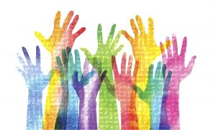
CAPACITY STRENGTHENING WORKSHOP
Youth Sexuality and Intersections with Education, Health, Employment, Law, and Citizenship
Notes:
Photo source: http://www.themreport.com/wp-content/uploads/2018/01/iStock-846997320-300x181.jpg

Slide 3
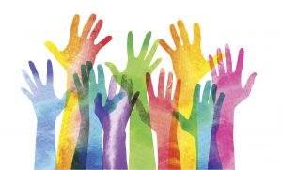
SESSION 3
Understanding Intersectionality

Slide 4
Session 3 Input
Intersectionality Framework

Slide 5
What is INTERSECTIONALITY?
“…a lens through which you can see where power comes and collides, where it interlocks and intersects. It’s not simply that there’s a race problem here, a gender problem here, and a class or LBGTQ problem there. Many times that framework erases what happens to people who are subject to all of these things.”
(Kimberly Crenshaw)
Notes:
Source: “Kimberlé Crenshaw on Intersectionality, More than Two Decades Later.” Columbia Law School. June 8, 2017. http://www.law.columbia.edu/news/2017/06/kimberle-crenshaw-intersectionality.

Slide 6
What is INTERSECTIONALITY?
A tool for analysis, theory, methodology, paradigm, lens, or framework
“… refers to the ways in which race, class, gender, age, sexuality, disability, and other categories of difference interact, and the implications of these interactions for relations of power.”
“a theoretical framework that posits that multiple social categories (e.g., race, ethnicity, gender, sexual orientation, and socioeconomic status) intersect at the micro level of individual experience to reflect multiple interlocking systems of privilege and oppression at the macro, social-structural level (e.g., racism, sexism, heterosexism).”
Notes:
Sources:
Bowleg, Lisa. “The Problem with the Phrase Women and Minorities: Intersectionality—An Important Theoretical Framework for Public Health.” American Journal of Public Health, 102(7): 1267-1273; 2012. https://www.ncbi.nlm.nih.gov/pmc/articles/PMC3477987/.
Konstantoni, Kristina; Kustatscher, Marlies; and Emejulu, Akwugo. “Travelling with Intersectionality Across Time, Place, and Space.” Children’s Geographies, 15: 1-5, 2017. http://www.tandfonline.com/doi/full/10.1080/14733285.2016.1255838?src=recsys.

Slide 7
What is INTERSECTIONALITY?
“…recognise[s] the heterogeneity of different social groups [like young people] and examine[s] how particular individuals and groups are both systematically marginalised in different spaces, places, and times, but also use their positions at the intersections of certain categories as resources for activism and resistance.”
Empowers the individual to make a sense of their own reality.
Notes:
Source: Konstantoni, Kristina; Kustatscher, Marlies; and Emejulu, Akwugo. “Travelling with Intersectionality Across Time, Place, and Space.” Children’s Geographies, 15: 1-5, 2017. http://www.tandfonline.com/doi/full/10.1080/14733285.2016.1255838?src=recsys.

Slide 8
A Bit of History
Brought to life in the late 1970s and early 80s by African American feminists like Bell Hooks and Angela Davis.
Term coined in 1989 by feminist, civil rights advocate, and law professor Kimberlé Crenshaw as a means to explain the oppression of African-American women.
Later mainstreamed into female social justice discourse by Patricia Hill Collins with her “matrix of domination” (1990).
These feminist scholars discussed gender, race, and class, and the important ways in which they overlapped.
Feminist scholars from all over the world were developing similar theories regarding intersectionality separately yet simultaneously–proof that its presence was needed in many different communities.
Intersectionality has changed our analysis of privilege and oppression.
Notes:
Source:
SALTO Youth. “Underpinning Principles: Intersectionality.” https://www.salto-youth.net/rc/inclusion/archive/archive-resources/inclusiongroups/inclusionethnicminorities/InclusionIntersectionality/.
Vaaler, Angelina. “What is Intersectionality?” AMP Global Youth. https://ampglobalyouth.org/students/what-is-intersectionality/.

Slide 9
Intersectionality tells us…
Age is not the only factor relevant to young people’s experiences. The ways gender, sexuality, class, ability, health status, marital status, religion, race, ethnicity, nationality, and/or citizenship status condition young people’s experiences is as relevant.

Slide 10
Intersectionality tells us…
When discussing ageism you may experience as a young person, you have to keep in mind the privilege that comes with your other identities, such as being a ‘straight’ male, or from being educated and coming from a well-off family, etc.

Slide 11
Intersectionality tells us…
We should not take it as a given that identities are whole, coherent, fixed things, inherent to who and what we are. They are a set of social forces convening in particular ways to shape our circumstances and experiences. Thus, listing identities is not enough; we always need to critique and analyse.

Slide 12
Intersectionality helps us understand how…
the convergence of multiple factors in young people’s lives takes place and, more specifically, how ageism, sexism, heterosexism, racism, class, and other grounds contribute to create layers of inequality that structure the positions of human beings. Intersectional injuries occur when multiple disadvantages or collisions interact to create a distinct and compounded dimension of disempowerment.
Notes:
SALTO Youth. “Underpinning Principles: Intersectionality.” https://www.salto-youth.net/rc/inclusion/archive/archive-resources/inclusiongroups/inclusionethnicminorities/InclusionIntersectionality/.

Slide 13
Intersectionality tells us…
Our complex mix of identities make up the equation of our empowerment and participation. Thus to empower young people and to influence how they participate (on the bases of equality and equity), we need to consider not just age, but other factors such as gender identity, sexual orientation, socio-economic status, ability, citizenship status, health status, marital status, religion, race, ethnicity, educational status, etc.

Slide 14
Why Intersectionality?
For us as activists to self-reflect, and examine our own identities and how they interact with the world in different ways. This will enable us to check our privilege while taking up others’ issues and lead towards becoming better allies.
For our activism to be an inclusive process. Without considering intersectionality, youth activism/youth movements will fail to include marginalised young people, including young LGBT persons, young people with disabilities, young sex workers, young migrants, young people living with HIV, young people who use drugs, young pregnant women, young people who have experienced sexual abuse, and others.
Notes:
Sources:
AWID. “Intersectionality: A Tool for Intersectionality: A Tool for Intersectionality: A Tool for Gender and Economic Justice Gender and Economic Justice.” https://lgbtq.unc.edu/sites/lgbtq.unc.edu/files/documents/intersectionality_en.pdf.
SALTO Youth. “Underpinning Principles: Intersectionality.” https://www.salto-youth.net/rc/inclusion/archive/archive-resources/inclusiongroups/inclusionethnicminorities/InclusionIntersectionality/.

Slide 15
Why Intersectionality?
To go beyond saying youth are not a homogenous group, and to ensure that we do not obscure and invisibilise certain experiences and issues.
To fully recognise that young people have complex lives with multiple identities and thus, may face intersectional discrimination/oppression/marginalisation.
To link the basis for discrimination (e.g., gender, sexual orientation, age, etc.) to the social, economic, political, and legal environment that contributes to discrimination and structures experiences of privilege and oppression.
Notes:
Sources:
AWID. “Intersectionality: A Tool for Intersectionality: A Tool for Intersectionality: A Tool for Gender and Economic Justice Gender and Economic Justice.” https://lgbtq.unc.edu/sites/lgbtq.unc.edu/files/documents/intersectionality_en.pdf.
SALTO Youth. “Underpinning Principles: Intersectionality.” https://www.salto-youth.net/rc/inclusion/archive/archive-resources/inclusiongroups/inclusionethnicminorities/InclusionIntersectionality/.

Slide 16
Why Intersectionality?
To identify patterns of discrimination/oppression.
To understand the risks: marginalised young people run multiple risks when they challenge norms. For example, bisexual Muslim young women run the risk of being excluded from their patriarchal society for being women, from their own religious community for their sexual orientation, from the lesbian community for being bisexual, and from the majority society for being Muslim.
Notes:
Sources:
AWID. “Intersectionality: A Tool for Intersectionality: A Tool for Intersectionality: A Tool for Gender and Economic Justice Gender and Economic Justice.” https://lgbtq.unc.edu/sites/lgbtq.unc.edu/files/documents/intersectionality_en.pdf.
SALTO Youth. “Underpinning Principles: Intersectionality.” https://www.salto-youth.net/rc/inclusion/archive/archive-resources/inclusiongroups/inclusionethnicminorities/InclusionIntersectionality/.

Slide 17
Why Intersectionality?
For our advocacy and programming to consider the various ways that different systems of marginalisation & oppression interact to marginalise various groups. How do these systems collude to prevent young people in all their diversity from being able to access opportunities, resources, and services and from being able to realise rights?
To understand that approaches/strategies/projects that work with one group of young people would not necessarily succeed for other marginalised groups.
To find ways to address these different barriers, and oppose and dismantle these power systems.

Slide 18
Some types of oppression
Systems of power where there are dominant and non-dominant groups
Dimensions of Diversity | “ism” | Dominant Group/s | Non-dominant Group/s
Ability | Ableism | Able-bodied people, people of “sound” mind | People with disabilities (physical, mental, psychosocial, learning, etc.)
Age | Ageism | (context-dependent) Adults Young People | Children and adolescents Elderly
Body Size | Sizeism | “Slim” people | People labelled as overweight, people of short stature
Education | Elitism | Formally educated persons | Informally educated persons, non-literate persons
Gender | Sexism | Men, gender-conforming persons | Women, non-gender confirming persons
 | Cissexism | Cisgender people | Transgender persons
National Origin | Ethnocentrism | Citizens | Migrants, refugees
Race | Racism | Caucasians | People of colour
Religion | Religious Oppression | People from dominant religions (e.g, Hindus in India) | People from non-dominant religions (e.g., Muslims in India)
Sexual Orientation | Heterosexism | Heterosexuals | Homosexuals, LGBTQI people
Notes:
Source: Adapted from Avarna. “The Power House Activity.” https://theavarnagroup.com/wp-content/uploads/2015/11/The-Power-House-Activity.pdf.

Slide 19
Some types of oppression
 | Cissexism | Cisgender people | Transgender persons
National Origin | Ethnocentrism | Citizens | Migrants, refugees
Race | Racism | Caucasians | People of colour
Religion | Religious Oppression | People from dominant religions (e.g, Hindus in India) | People from non-dominant religions (e.g., Muslims in India)
Sexual Orientation | Heterosexism | Heterosexuals | Homosexuals, LGBTQI people
Notes:
Source: Adapted from Avarna. “The Power House Activity.” https://theavarnagroup.com/wp-content/uploads/2015/11/The-Power-House-Activity.pdf.

Slide 20
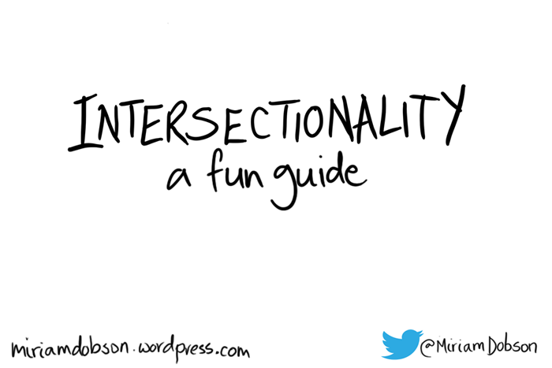
In summary…

Slide 21
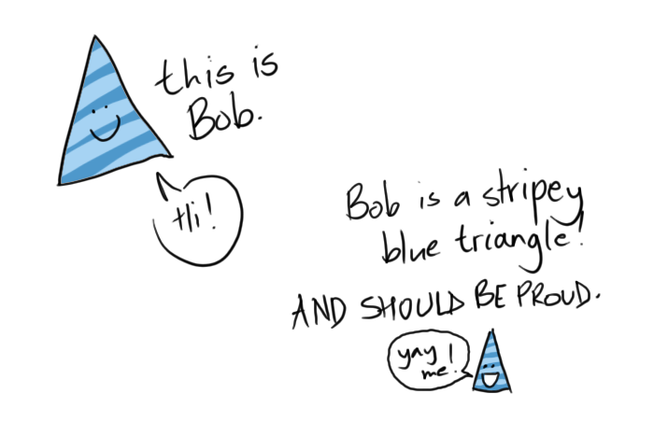

Slide 22
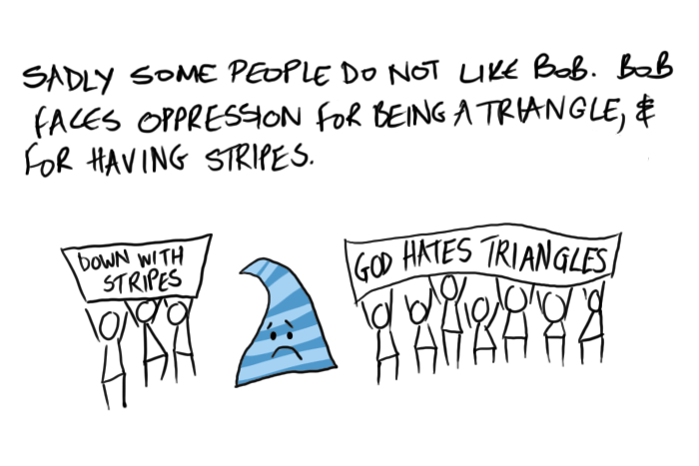

Slide 23
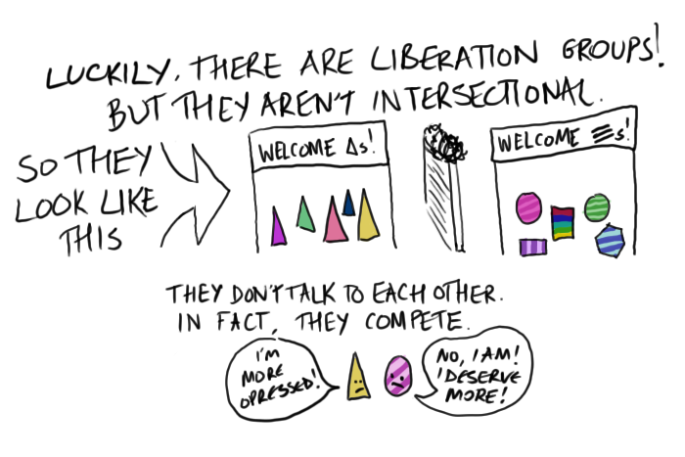

Slide 24
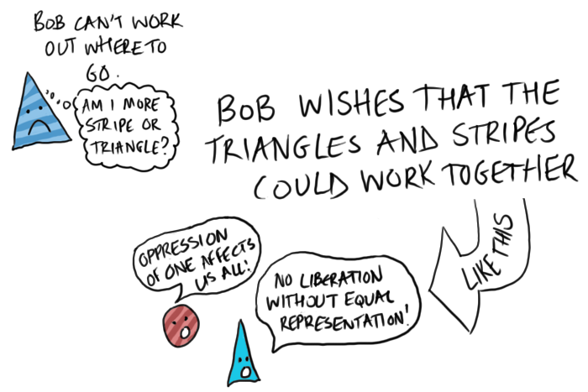

Slide 25
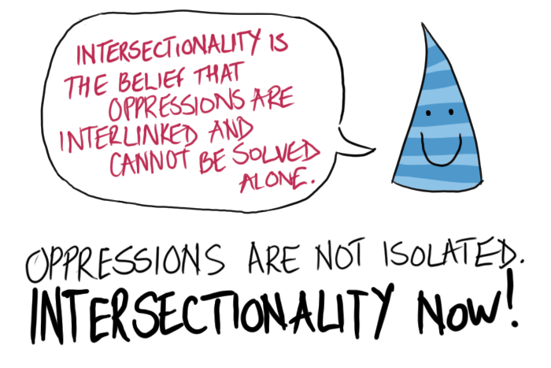

Slide 26
Moving Forward
The rest of the workshop will be looking at how intersections play out in different arenas that are crucial for young people: education, health, employment, law, and citizenship.

Slide 27

Q & A

Slide 28

Discussion
Q & A

