Slide 1
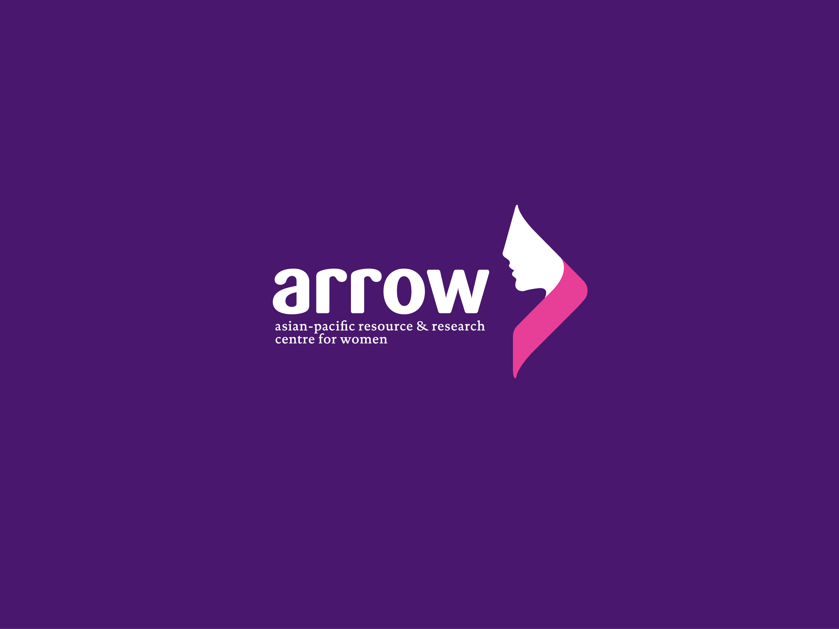

Slide 2
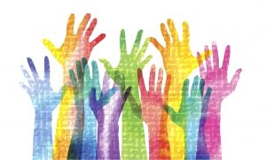
CAPACITY STRENGTHENING WORKSHOP
Youth Sexuality and Intersections with Education, Health, Employment, Law, and Citizenship
Notes:
Photo source: http://www.themreport.com/wp-content/uploads/2018/01/iStock-846997320-300x181.jpg

Slide 3
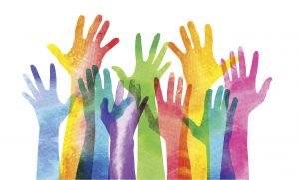
SESSION 2
Understanding Basic Sexuality Concepts

Slide 4
Gender and Sexuality
Some Definitions

Slide 5
What is SEXUALITY?
“…a central aspect of being human throughout life encompasses sex, gender identities and roles, sexual orientation, eroticism, pleasure, intimacy and reproduction. Sexuality is experienced and expressed in thoughts, fantasies, desires, beliefs, attitudes, values, behaviours, practices, roles and relationships. While sexuality can include all of these dimensions, not all of them are always experienced or expressed. Sexuality is influenced by the interaction of biological, psychological, social, economic, political, cultural, legal, historical, religious, and spiritual factors.” (WHO)
Notes:
http://www.who.int/reproductivehealth/topics/sexual_health/sh_definitions/en/

Slide 6
What is SEX?
“Sex refers to the biological characteristics that define humans as female or male. While these sets of biological characteristics are not mutually exclusive, as there are individuals who possess both, they tend to differentiate humans as males and females. In general use in many languages, the term sex is often used to mean “sexual activity,” but for technical purposes in the context of sexuality and sexual health discussions, the above definition is preferred...” (WHO)
Notes:
http://www.who.int/reproductivehealth/topics/sexual_health/sh_definitions/en/

Slide 7
What is GENDER?
Gender is how societies view men and women, the differences between them, and the roles assigned to them. It is different from sexuality, though interrelated. It is socially constructed, and are influenced by the interaction of biological, psychological, social, and historical factors, amongst others. It varies from society to society and over time, and thus amenable to change.

Slide 8
What are GENDER ROLES?
“…the particular economic, social roles and responsibilities considered appropriate for women and men in a given society. Gender roles and characteristics do not exist in isolation, but are defined in relation to one another and through the relationship between women and men, girls and boys.”
Notes:
Source: Medical Women’s International Association. Training Manual for Adolescent Sexuality. 2013 ed. http://mwia.net/wp-content/uploads/2013/07/TrainingManualforAdolescentSexuality.pdf

Slide 9
What is GENDER ROLE SOCIALISIATION?
“…means that different societies have different ideas of what constitutes male and female behaviour. A fuller understanding of gender includes recognition of gender as a social construct, as a system of social stratification and an institution that structures every aspect of our lives because of is embeddedness in the family, the workplace, the health care system and the state as well as in sexuality, language, and culture. It is a primary way of signifying relationships of power. Each culture is deeply invested in its construction of gender roles and those who benefit from the existing system may strongly resist efforts to change, or even describe it..”
Notes:
Source: Medical Women’s International Association. Training Manual for Adolescent Sexuality. 2013 ed. http://mwia.net/wp-content/uploads/2013/07/TrainingManualforAdolescentSexuality.pdf

Slide 10
The Genderbread Person
References:
Health Policy Project. Gender and Sexual Diversity Training. 2015. https://www.healthpolicyproject.com/index.cfm?id=GSDTraining.
Killerman, Sam. “Genderbread Person v 3.” It’s Pronounced Metrosexual. http://itspronouncedmetrosexual.com/2015/03/the-genderbread-person-v3/.
Notes:
Killerman, Sam. “Breaking Through the Binary: Gender Explained Using Continuums.” https://www.genderbread.org/wp-content/uploads/2017/02/Breaking-through-the-Binary-by-Sam-Killermann.pdf.

Slide 12
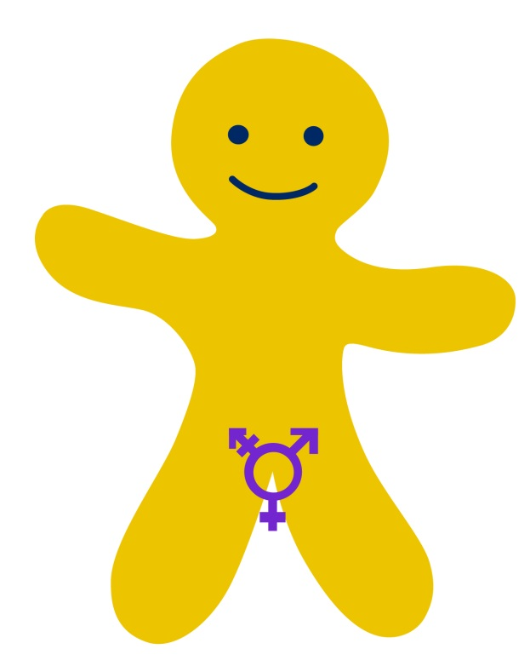
Biological Sex
A medical term used to refer to the chromosomal, hormonal, and anatomical characteristics that are used to classify an individual as female, male, intersex, MtF (male-to-female) female, (female-to-male) FtM male.
Intersex: An umbrella term that refers to a variety of chromosomal, hormonal, and anatomical conditions in which a person does not seem to fit the typical definitions of female or male.
Notes:
Biological sex refers to the objectively measurable organs, hormones, and chromosomes you possess. Being female means having a vagina, ovaries, two X chromosomes, predominant estrogen, and you can grow a baby in your stomach area. Being male means having testes, a penis, an XY chromosome configuration, predominant testosterone, and you can put a baby in a female’s stomach area. Being intersex can be any combination of what I just described. For example, someone can be born with the appearance of being male (penis, scrotum, etc.), but have a functional female reproductive system inside. There are many examples of how intersex can present itself.
Source for additional explanation: http://itspronouncedmetrosexual.com/2011/11/breaking-through-the-binary-gender-explained-using-continuums/

Slide 13
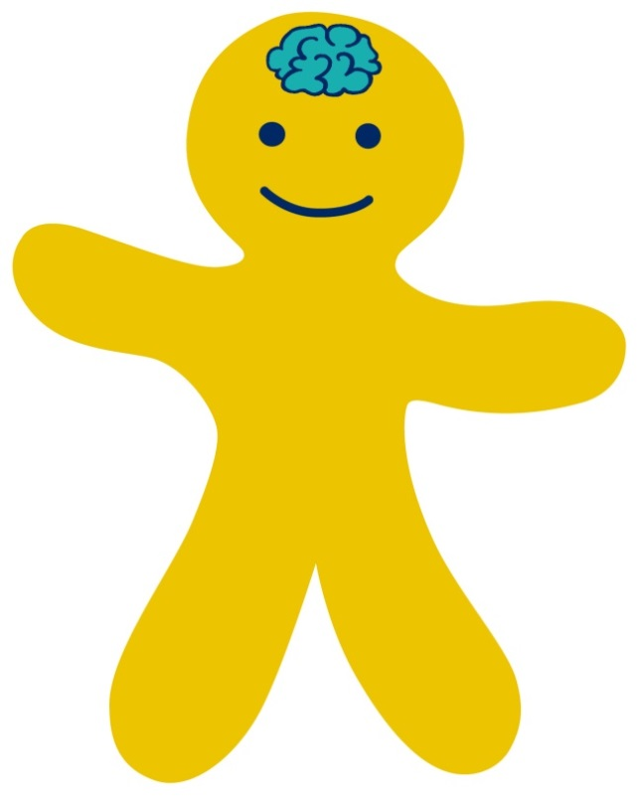
Gender Identity
A person’s deeply felt internal and individual experience of gender, which may or may not correspond with the sex assigned at birth. It’s how one, in one’s head, thinks about oneself.
Examples: Man, Woman, Transgender Person, Genderqueer, Agender, Two-spirit, etc.
Transgender Person: An umbrella term referring to an individual whose gender identity is different from their sex assigned at birth.
Notes:
Gender identity is all about how you, in your head, think about yourself. It’s about how you internally interpret the chemistry that composes you (e.g., hormone levels). As you know it, do you think you fit better into the societal role of “woman,” or “man,” or do neither ring particularly true for you? That is, are you somewhere in-between the two? Or do you consider your gender to fall outside of the spectrum completely? The answer is your gender identity.
Formation of identity is affected by hormones and environment just as much as it is by biological sex. Oftentimes, problems arise when someone is assigned a gender based on their sex at birth that doesn’t align with how they come to identify.
Source for additional explanation: http://itspronouncedmetrosexual.com/2011/11/breaking-through-the-binary-gender-explained-using-continuums/

Slide 14
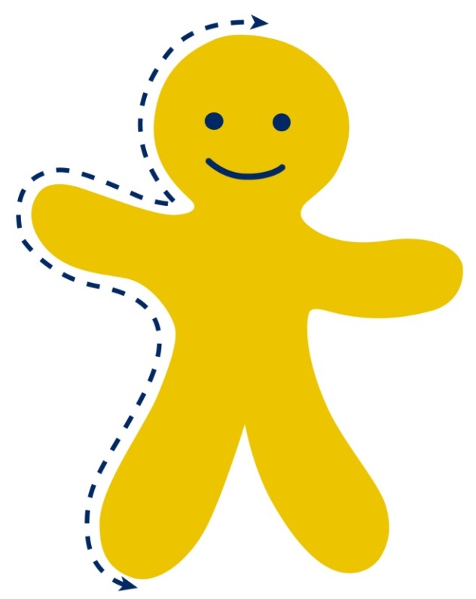
Gender Expression
The external display of one’s gender, through a combination of appearance, disposition, social behavior, and other factors, generally measured on a scale of masculinity and femininity.
Examples: Feminine, masculine, butch, femme, androgynous
Gender norms: A culturally-defined set of roles, responsibilities, rights, entitlements, and obligations, associated with being female and male, as well as the power relations between and among women and men, boys and girls.
Notes:
Gender expression is all about how you demonstrate your gender through the ways you act, dress, behave, and interact–whether that is intentional or unintended. Gender expression is interpreted by others perceiving your gender based on traditional gender roles (e.g., men wear pants, women wear dresses). Gender expression is something that often changes from day to day, outfit to outfit, event or setting to event or setting. It’s about how the way you express yourself aligns or doesn’t with traditional ways of gendered expression. And like gender identity, there is a lot of room for flexibility here. It is likely that you slide around on this continuum throughout the week without even thinking about it. How about an example?
You wake up and you’re wearing baggy grey sweatpants and a tshirt. As you walk into your kitchen to prepare breakfast, you’re expressing an adrogynous-to-slightly-masculine gender. However, you see your partner in the kitchen and you prowl in like Halle Berry from Catwoman, then you are expressing much more femininely, so now you’re back on the left half of the continuum. You pour a bowl of cereal, wrap your fist around a spoon like a viking, and start shoveling Fruit Loops into your face, and all-of-a-sudden you’re sliding back onto the right side of the continuum. After breakfast, you skip back into your bedroom and playfully place varying outfits in front of you, pleading your partner help you decide what to wear. You’re feminine again.
I assume this entire time you were imagining it was you, with your gender identity, acting out that example. Now go through the whole thing, but imagine someone with the a different gender identity from you going through the motions. Now you are starting to understand how these concepts interrelate, but don’t interconnect.
Source for additional explanation: http://itspronouncedmetrosexual.com/2011/11/breaking-through-the-binary-gender-explained-using-continuums/

Slide 15
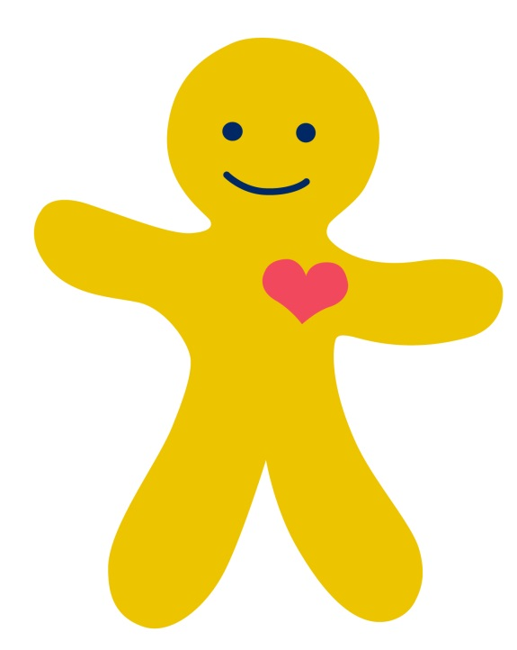
Sexual Orientation
An enduring emotional, romantic, or sexual attraction primarily or exclusively to people of a particular gender.
Heterosexuality: An enduring emotional, romantic, or sexual attraction primarily or exclusively to people of a different gender. People who are heterosexual often identify as “straight.”
Homosexuality: An enduring emotional, romantic, or sexual attraction primarily or exclusively to people of the same gender. People who are homosexual often identify as “gay” or “lesbian.”
Bisexuality: An enduring emotional, romantic, or sexual attraction to people of more than one gender. People who are bisexual often identify as “bisexual.”
Asexuality: An enduring absence of sexual attraction. People who are asexual often identify as “asexual.”
Notes:
Sexual orientation is all about who you are physically, spiritually, and emotionally attracted to. If you are male and you’re attracted to females, you’re “straight.” If you’re a male who is attracted to males and females, you’re bisexual. And if you’re a male who is attracted to males, you’re gay.
Source for additional explanation: http://itspronouncedmetrosexual.com/2011/11/breaking-through-the-binary-gender-explained-using-continuums/

Slide 16
Key Takeaways
Everyone has a biological sex, gender expression, gender identity, and sexual orientation. These exist on a continuuum and vary from person to person.
Gender identity, gender expression, biological sex, and sexual orientation are independent of each other (i.e., not connected/not interconnected)
Identity ≠ Expression ≠ Sex
Gender ≠ Sexual Orientation
Notes:
Gender identity, gender expression, biological sex, and sexual orientation are independent of one another (i.e., they are not connected).People’s sexual orientation doesn’t determine their gender expression. And their gender expression isn’t determined by their gender identity. And their gender identity isn’t determined by their biological sex. And also every other mismatch of A isn’t determined by B combination you can dream up from those inputs. Those things certainly affect one another (i.e., they are related to one another) but they do not determine one another.
If someone is born with male reproductive organs and genitalia, he is very likely to be raised as a boy, identify as a man, and express himself masculinely. We call this identity “cisgender” (when your biological sex aligns with how you identify) and it grants a lot of privilege (read some of them in this list of cisgender privileges). It’s something most of us who have it don’t appreciate nearly as much as we should.
Source for additional explanation: http://itspronouncedmetrosexual.com/2011/11/breaking-through-the-binary-gender-explained-using-continuums/

Slide 17

Q & A

Slide 18

Discussion
Q & A

